Slide 1


SP3176 The Universe Chapter 7: The Expanding Universe
Lim Zhi Han

Slide 2
Learning Objectives
In this chapter, you will first examine Hubble’s 1929 data, and with the cosmological principle in mind develop an understanding of the expanding Universe. You will then apply some concepts you have learned in earlier chapters to construct models of the expanding Universe. By solving the cosmological models, you will be able to determine the evolution of our Universe in different energy conditions

Slide 3
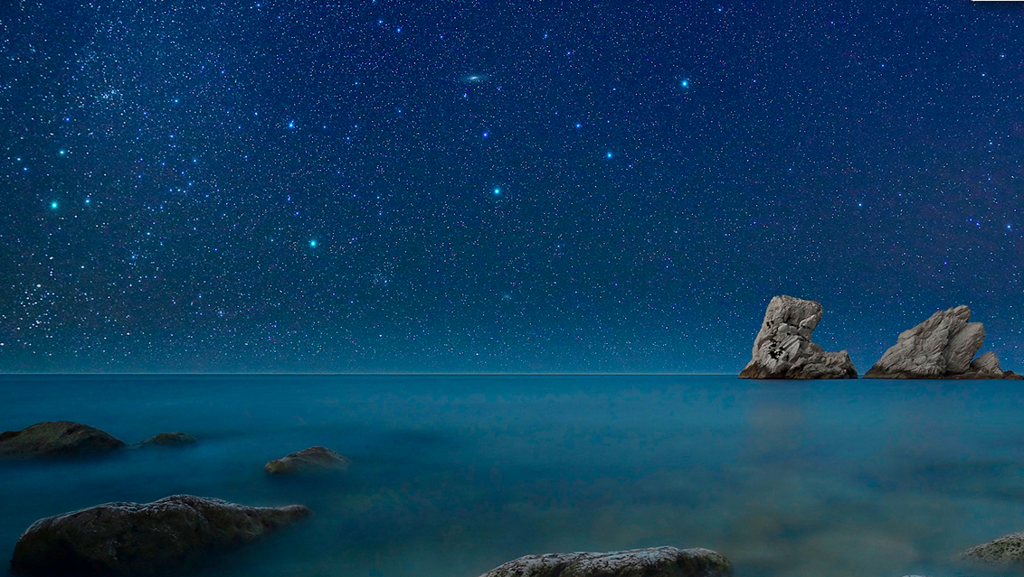
Ex. Spot the Andromeda galaxy
Credit: Andromeda on the Rocks, By Christian Fattinnanzi,
http://apod.nasa.gov/apod/ap130927.html

Slide 4
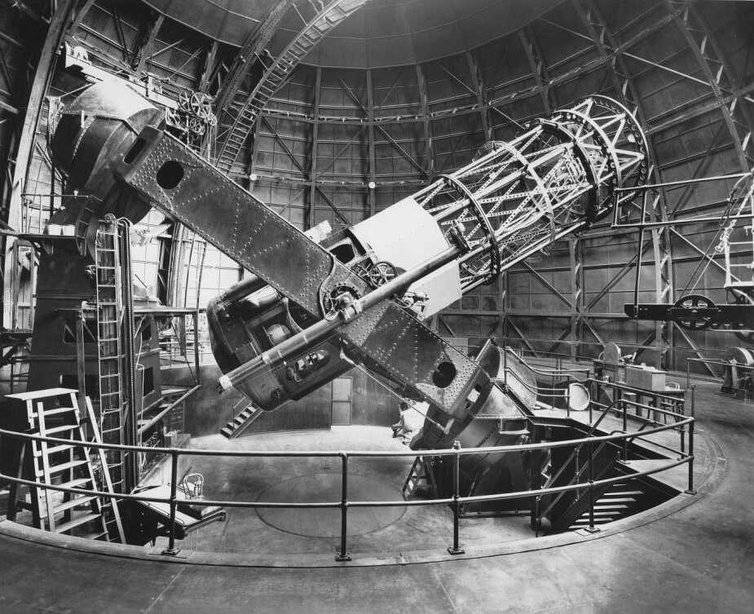
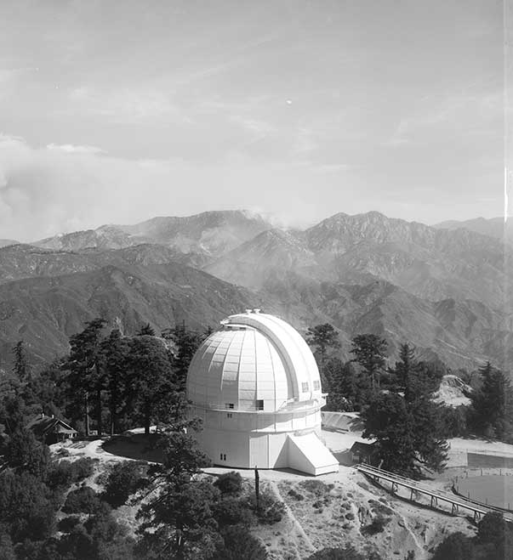
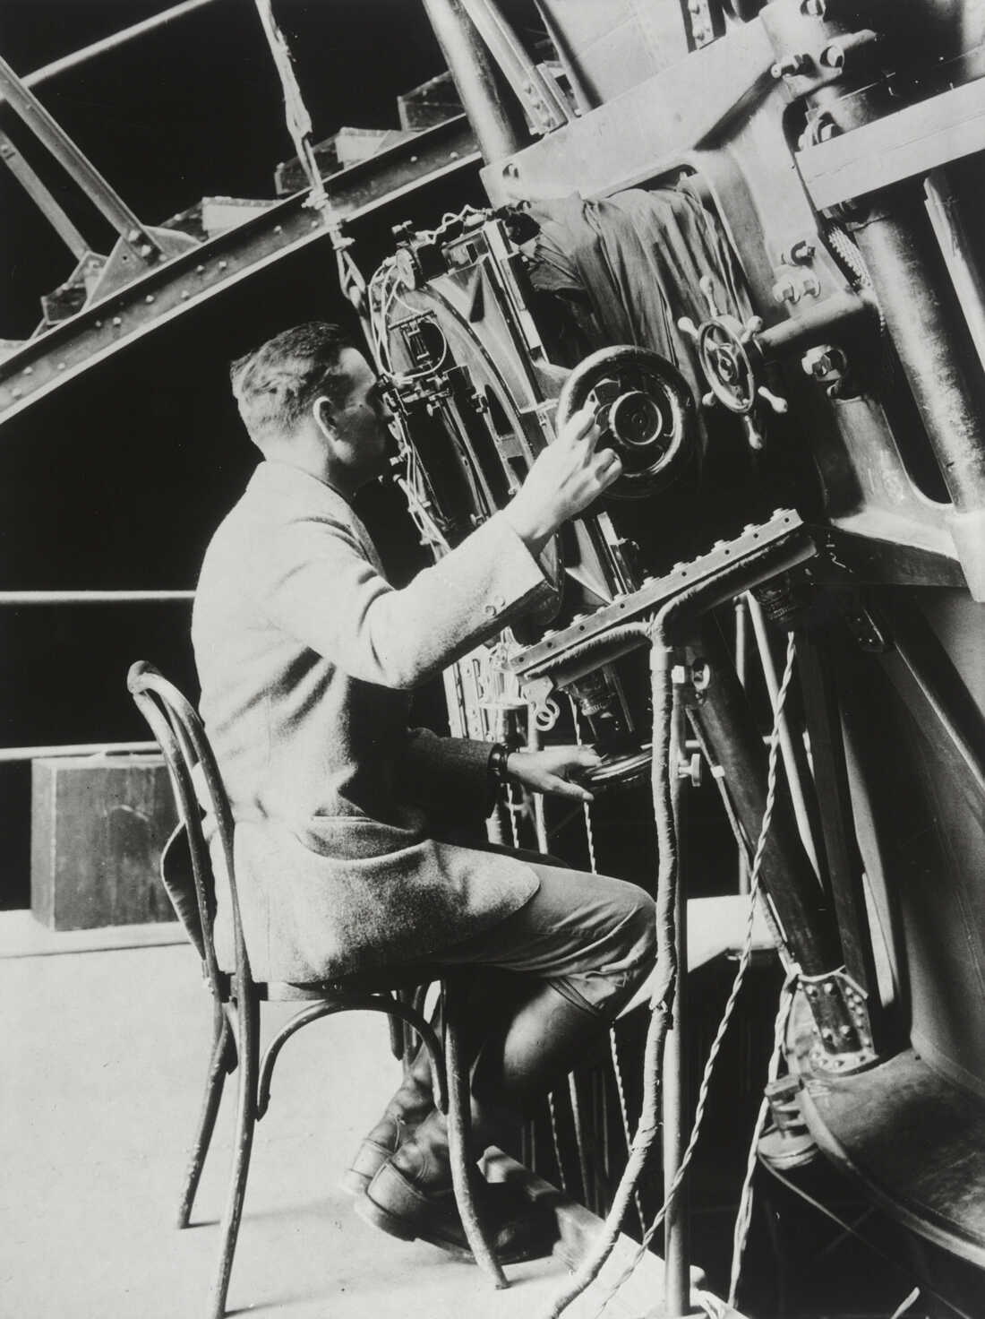
Milton Humason & Edwin Hubble
Used the 100-inch Hooke telescope in 1920-1930s to make some of the most important astronomical discoveries.

Slide 5
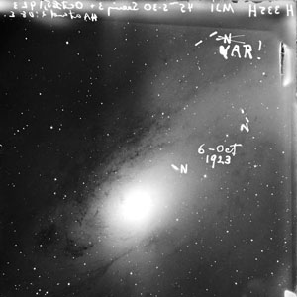
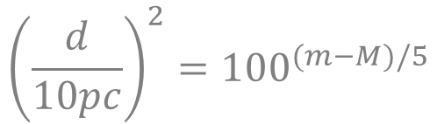

Hubble and Humason measured distance to galaxies.
After finding Cepheids in galaxies.
$$M=−2.76\log_{10}{P−1.40}$$
$${\left(\frac{d}{10pc}\right)}^{2}={100}^{(m−M)/5}$$
Photograph of the first variable star in a galaxy (Andromeda) observed in 1923 by Hubble.
Image credit: Carnegie Science

Slide 6
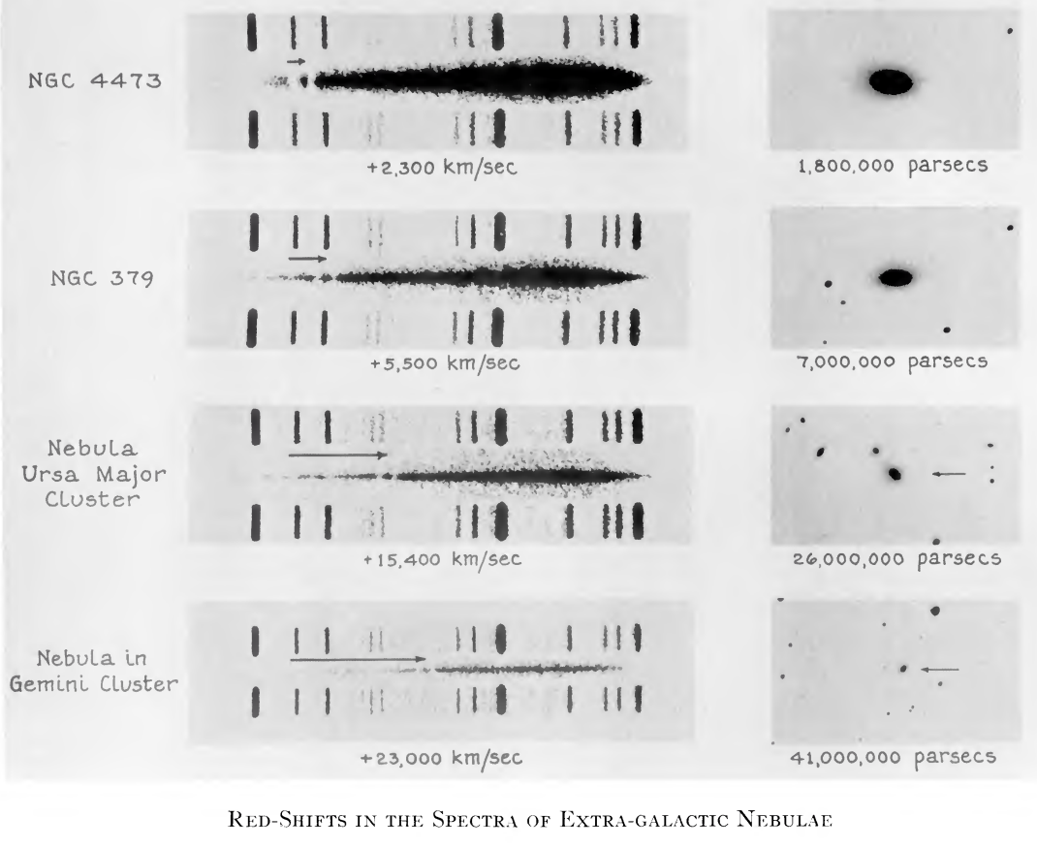
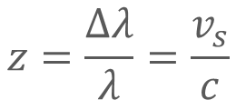
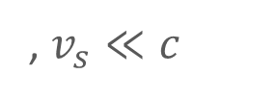
Hubble and Humason measured velocities of galaxies.
Took spectra of galaxies and observed redshift.
$$z=\frac{Δλ}{λ}=\frac{v_{s}}{c}$$
, $v_{s}≪c$

Slide 7
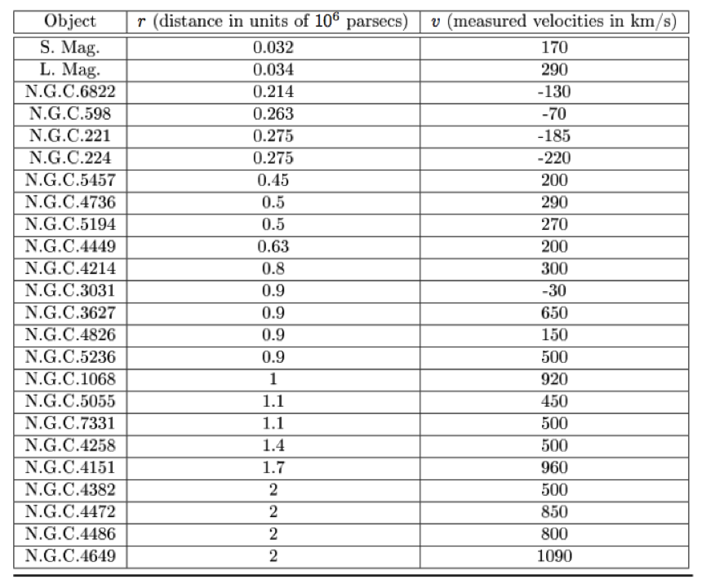
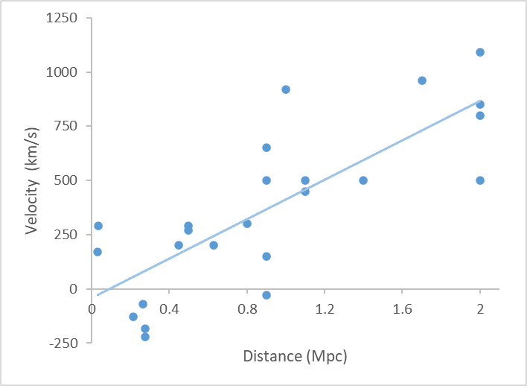
Hubble plotted velocity against distance and…

Slide 8
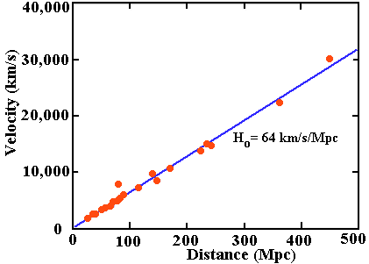

Hubble (1929)
Hubble’s Law $v=H_{0}d$
Reiss et al. (1996)

Slide 9
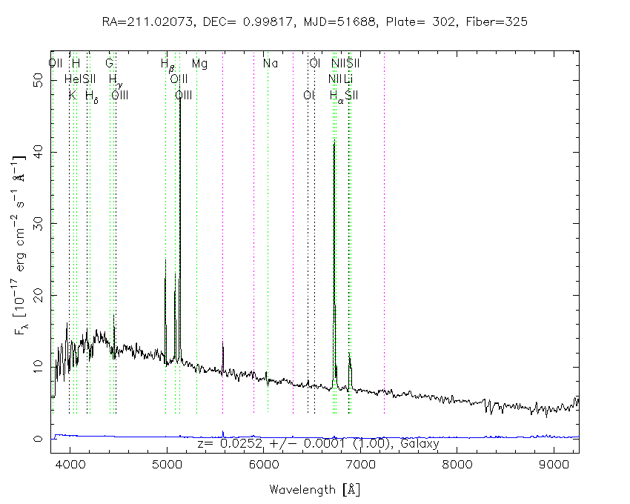
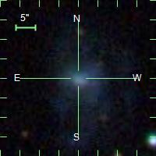
Spectrum of a galaxy
Spectrum of a galaxy# showing both continuous blackbody and discreet atomic emission peaks
# SDSS object 582093484903825431
Image credit: SDSS

Slide 10
Why do galaxies even move ?

Slide 11







Hubble’s Law $v=H_{0}d$
$$d$$
$$d$$
$$d$$
Milky Way
(that’s us!)
$$v$$
$$2v$$
$$3v$$
From Hubble’s law, galaxies “move away” from each other.
The further they are, the faster they move. Why???
Such movements cannot be explained by looking at individual galaxies. Need to look it as a whole-Universe phenomenon.

Slide 12
The Cosmological Principle
The Universe is Homogeneous and Isotropic.
Ex. Explain the words in bold.

Slide 13
The Cosmological Principle
The Universe is Homogeneous and Isotropic.
Ex. The cosmological principle implies that any observer looking at galaxies will find their radial velocities to be proportional to their distances. Why?

Slide 14
Ex. The cosmological principle implies that any observer looking at galaxies will find their radial velocities to be proportional to their distances. Why?

Slide 15
Cosmological redshift
Definition of Redshift:
The expansion of space expands all length scales (including wavelengths)

Slide 16
Cosmological redshift
Distance
Recession velocity
Hubble Parameter
For small or

Slide 17
Cosmological redshift
Ex. What is the difference between Doppler redshift and Cosmological redshift?

Slide 18
Cosmological Redshift
From Hubble’s data, galaxies “move away” from each other.
Why???
A: They are not moving! Instead, we model the Universe whereby space itself is expanding, carrying the galaxies along with it.
The galaxies are carried along with the expanding space, and becomes further away from each other.

Slide 19
An analogy: Launching a ball into space
Initial velocity too low
Initial velocity too high
Ball reaches max. height and drop back down
Ball escapes to infinity with excess velocity
Exists a critical velocity where the ball can escape, but with a final zero velocity at infinity

Slide 20



An analogy: Launching a ball into space
Ball reaches max. height and drop back down
Ball escapes to infinity with excess velocity
Density $ρ$ too high
Density $ρ$ too low
Exists a critical density $ρ_{critical}$ where the ball can escape, but with a final zero velocity at infinity

Slide 21
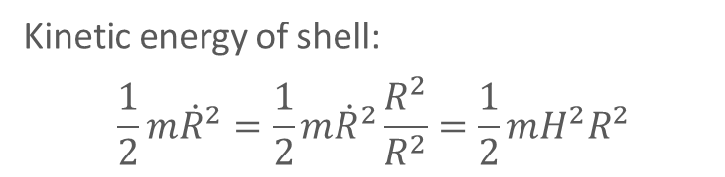
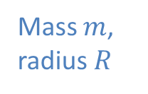


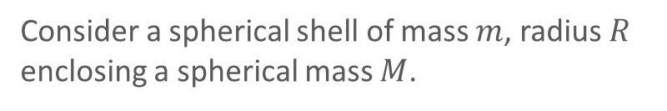

Newtonian model of an Expanding Universe
Consider a spherical shell of mass $m$, radius $R$ enclosing a spherical mass $M$.
The shell moves radially outwards with speed
$$\dot{R}=\frac{dR}{dt}$$
Mass $m$,
radius $R$
$$M$$
Kinetic energy of shell:
$$\frac{1}{2}m{\dot{R}}^{2}=\frac{1}{2}m{\dot{R}}^{2}\frac{R^{2}}{R^{2}}=\frac{1}{2}mH^{2}R^{2}$$
$$where H=\frac{\dot{R}}{R}$$

Slide 22
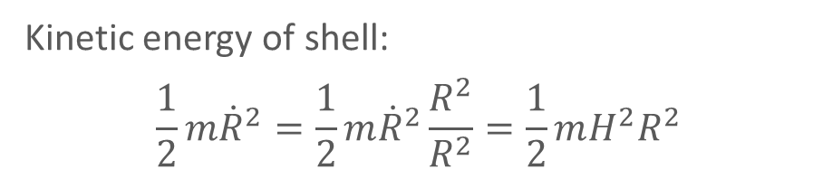
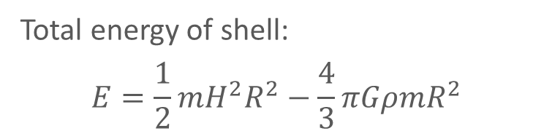
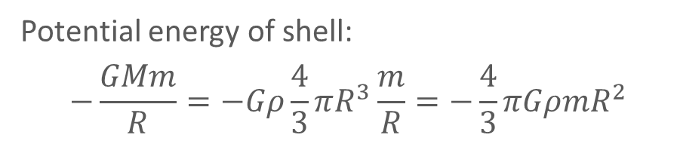
Newtonian model of an Expanding Universe
Kinetic energy of shell:
$$\frac{1}{2}m{\dot{R}}^{2}=\frac{1}{2}m{\dot{R}}^{2}\frac{R^{2}}{R^{2}}=\frac{1}{2}mH^{2}R^{2}$$
Total energy of shell:
$$E=\frac{1}{2}mH^{2}R^{2}−\frac{4}{3}πGρmR^{2}$$
Potential energy of shell:
$$−\frac{GMm}{R}=−Gρ\frac{4}{3}πR^{3}\frac{m}{R}=−\frac{4}{3}πGρmR^{2}$$
Ex. What happens if Gravitational Potential energy > Kinetic energy?
And vice versa?

Slide 23

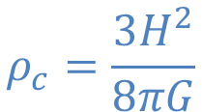
Newtonian model of an Expanding Universe
Ex. A$t E=0$, what is the density $ρ$?
$$E=\frac{1}{2}mH^{2}R^{2}−\frac{4}{3}πGρmR^{2}$$
$$ρ_{c}=\frac{3H^{2}}{8πG}$$
Critical density.
Density at which Universe is just able to expand forever.

Slide 24
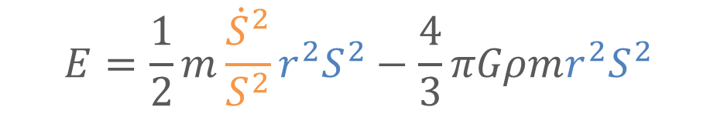
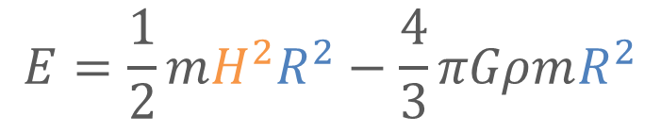
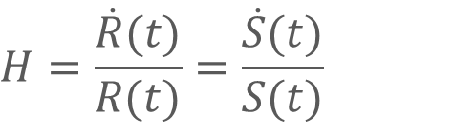


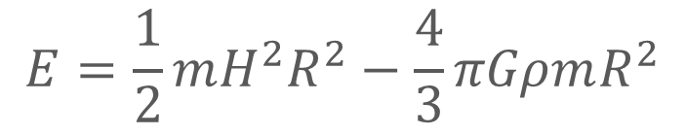
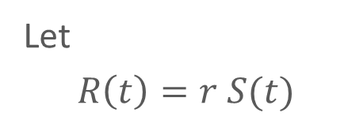
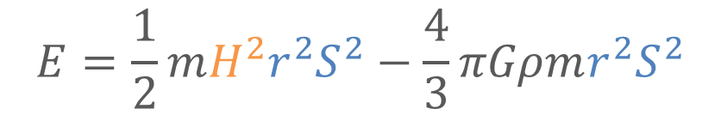
Newtonian model of an Expanding Universe
Let
$$R\left(t\right)=r S(t)$$
$$H=\frac{\dot{R}(t)}{R(t)}=\frac{\dot{S}(t)}{S(t)}$$
$$\dot{R}\left(t\right)=r \dot{S}(t)$$
$$\ddot{R}\left(t\right)=r \ddot{S}(t)$$
$$E=\frac{1}{2}m\frac{{\dot{S}}^{2}}{S^{2}}r^{2}S^{2}−\frac{4}{3}πGρmr^{2}S^{2}$$
$$E=\frac{1}{2}mH^{2}r^{2}S^{2}−\frac{4}{3}πGρmr^{2}S^{2}$$
$$E=\frac{1}{2}mH^{2}R^{2}−\frac{4}{3}πGρmR^{2}$$
$$E=\frac{1}{2}mH^{2}R^{2}−\frac{4}{3}πGρmR^{2}$$

Slide 25

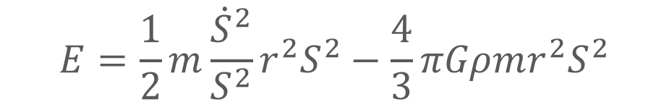



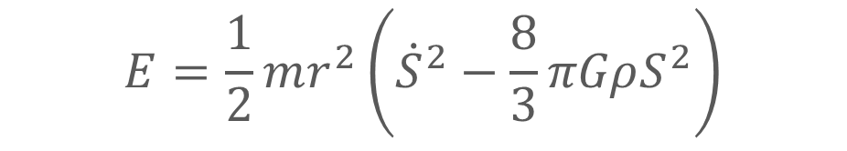

Newtonian model of an Expanding Universe
$$E=\frac{1}{2}m\frac{{\dot{S}}^{2}}{S^{2}}r^{2}S^{2}−\frac{4}{3}πGρmr^{2}S^{2}$$
$$E=\frac{1}{2}m\frac{{\dot{S}}^{2}}{S^{2}}r^{2}S^{2}−\frac{4}{3}πGρmr^{2}S^{2}$$
$$E=\frac{1}{2}mr^{2}\left({\dot{S}}^{2}−\frac{8}{3}πGρS^{2}\right)$$
$$E=\frac{1}{2}mr^{2}\left({\dot{S}}^{2}−\frac{8}{3}πGρS^{2}\right)$$
$$−kc^{2}={\dot{S}}^{2}−\frac{8}{3}πGρS^{2}$$
$$−kc^{2}={\dot{S}}^{2}−\frac{8}{3}πGρS^{2}$$
$${\dot{S}}^{2}+kc^{2}=\frac{8}{3}πGρS^{2}$$

Slide 26
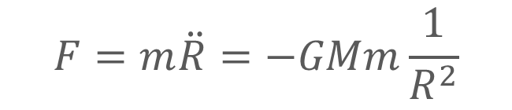
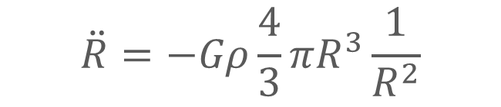



Newtonian model of an Expanding Universe
$$\ddot{R}=−Gρ\frac{4}{3}πR^{3}\frac{1}{R^{2}}$$
$$F=m\ddot{R}=−GMm\frac{1}{R^{2}}$$
$$R\left(t\right)=r S(t)$$
$$\ddot{S}=−\frac{4}{3}πGρS$$
$$\ddot{R}\left(t\right)=r \ddot{S}(t)$$

Slide 27
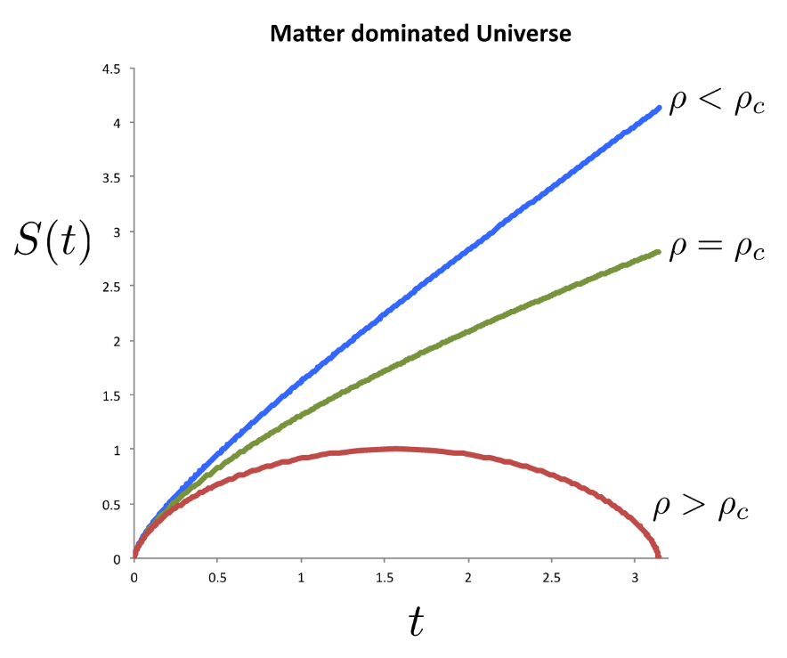
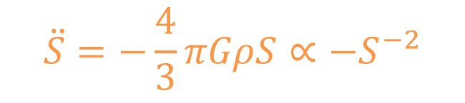

Newtonian model of an Expanding Universe
$${\dot{S}}^{2}+kc^{2}=\frac{8}{3}πGρS^{2}∝S^{−1}$$
$$\ddot{S}=−\frac{4}{3}πGρS∝−S^{−2}$$
Solve the differential equations to obtain $S\left(t\right)$.
$S\left(t\right)$ tells the story of how the size of the Universe evolves.

Slide 28

Newtonian model of an Expanding Universe
Ex. $k$ can be either positive or negative. What decides the sign of $k$? Hint: Check how does $k$ relate to energy. How does the sign of $k$ affect the evolution of the Universe?

Slide 29
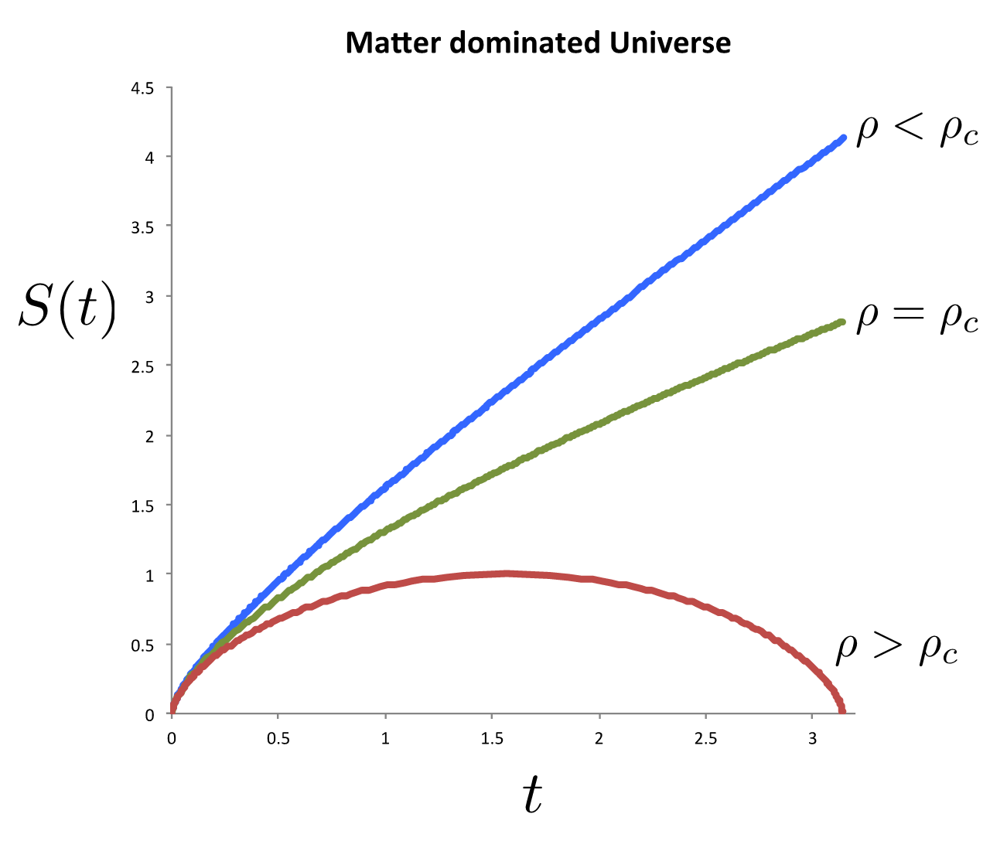
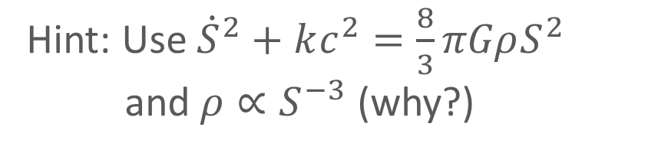
Newtonian model of an Expanding Universe
Hint: Use ${\dot{S}}^{2}+kc^{2}=\frac{8}{3}πGρS^{2}$ and $ρ{∝S}^{−3}$ (why?)
Ex. Reproduce the following plots.

Slide 30
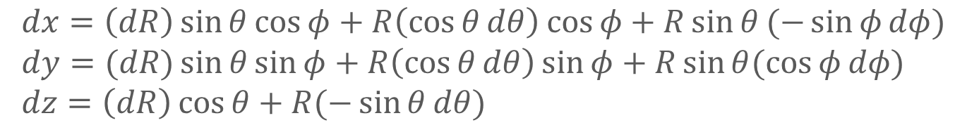
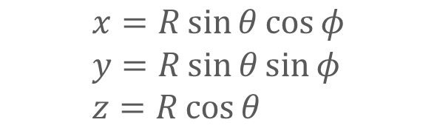
Metric of (flat) space in spherical coordinates
Space metric:
$$dl^{2}=dx^{2}+dy^{2}+dz^{2}$$
Cartesian to spherical coordinates:
$$x=R\sin{θ\cos{φ}} \\ y=R\sin{θ\sin{φ}} \\ z=R\cos{θ}$$
The differentials:
$$dx=\left(dR\right)\sin{θ\cos{φ}}+R\left(\cos{θ}dθ\right)\cos{φ}+R\sin{θ}(−\sin{φ}dφ) \\ dy=(dR)\sin{θ\sin{φ}+R\left(\cos{θ}dθ\right)\sin{φ}+R\sin{θ(\cos{φ}dφ)}} \\ dz=\left(dR\right)\cos{θ}+R(−\sin{θ}dθ)$$
Space metric in spherical coordinates:
$$dl^{2}=dR^{2}+R^{2}dθ^{2}+R^{2}\sin^{2}{θ}dφ^{2}$$

Slide 31

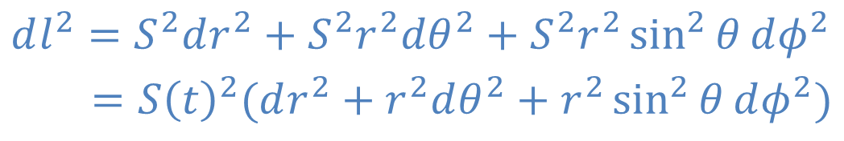
Metric of expanding (flat) space
Space metric:
$$dl^{2}=dR^{2}+R^{2}dθ^{2}+R^{2}\sin^{2}{θ}dφ^{2}$$
Time dependent distance:
$$R\left(t\right)=rS(t)$$
$$dR≡R_{2}−R_{1}=r_{2}S−r_{1}S=Sdr$$
Expanding space metric:
$$dl^{2}=S^{2}dr^{2}+S^{2}r^{2}dθ^{2}+S^{2}r^{2}\sin^{2}{θ}dφ^{2} \\ =S{\left(t\right)}^{2}(dr^{2}+r^{2}dθ^{2}+r^{2}\sin^{2}{θ}dφ^{2})$$

Slide 32
What is the sum of angles of a triangle in flat space?
(not a trick question)
Activity
On a ball, define a North pole, South pole and equator.
Form a triangle with 2 longitudinal lines and the equator.
Find the sum of the angles in the triangle.

Slide 33
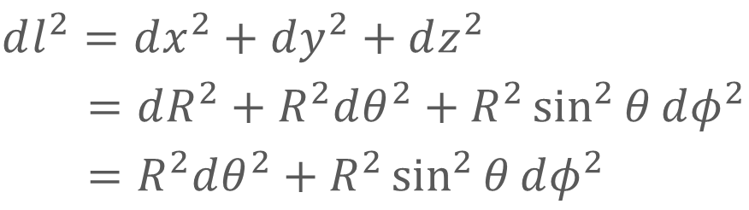
Metric of positively curved space
2-Sphere:
A 2-dimensional positively curved surface embedded on a 3-dimensional ball.
3D ball:
$$x^{2}+y^{2}+z^{2}=R^{2} , R fixed$$
Metric:
$$dl^{2}=dx^{2}+dy^{2}+dz^{2} \\ =dR^{2}+R^{2}dθ^{2}+R^{2}\sin^{2}{θ}dφ^{2} \\ =R^{2}dθ^{2}+R^{2}\sin^{2}{θ}dφ^{2}$$
How many variables are there in the metric?

Slide 34

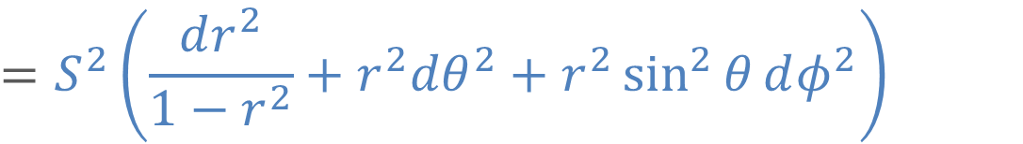
Metric of positively curved space
3-Sphere:
A 3-dimensional positively curved surface embedded on a 4-dimensional ball.
4D ball:
$$w^{2}+x^{2}+y^{2}+z^{2}=S^{2} , S fixed in space$$
$$w^{2}+R^{2}=S^{2} ,R not fixed in space$$
Metric:
$$dl^{2}=dw^{2}+dx^{2}+dy^{2}+dz^{2}$$
$$R=rS$$
$$=S^{2}\left(\frac{dr^{2}}{1−r^{2}}+r^{2}dθ^{2}+r^{2}\sin^{2}{θ}dφ^{2}\right)$$
Details in L. notes pg 11
How many variables are there in the metric?

Slide 35
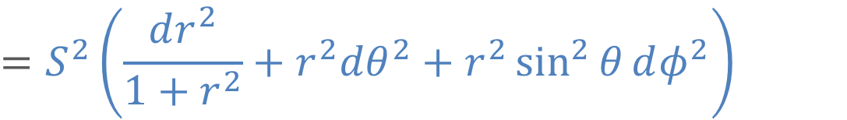
Metric of negatively curved space
3-Hyperbola:
A 3-dimensional negatively curved surface.
4D hyperboloid:
$$w^{2}−x^{2}−y^{2}−z^{2}=S^{2} , S fixed in space$$
$$w^{2}−R^{2}=S^{2} , R not fixed in space$$
Metric:
$$dl^{2}=−dw^{2}+dx^{2}+dy^{2}+dz^{2}$$
$$=S^{2}\left(\frac{dr^{2}}{1+r^{2}}+r^{2}dθ^{2}+r^{2}\sin^{2}{θ}dφ^{2}\right)$$

Slide 36
Adding the time dimension..
$$S fixed in space$$
$$Now allow S to vary in time. Allow Universe to expand/contract$$
$$Coordinates \left(r,θ, φ\right) do not vary in time.$$
$$Insert time differential into metric like in Minkowski space:−c^{2}dt^{2}$$

Slide 37
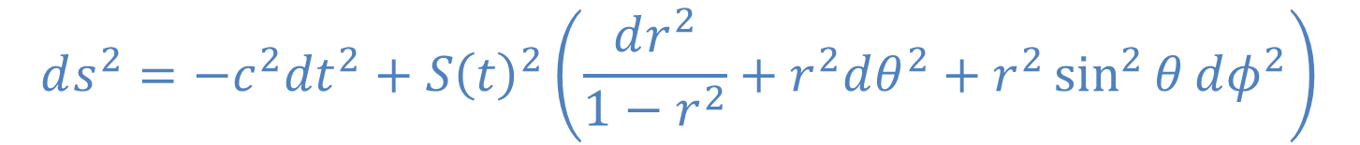
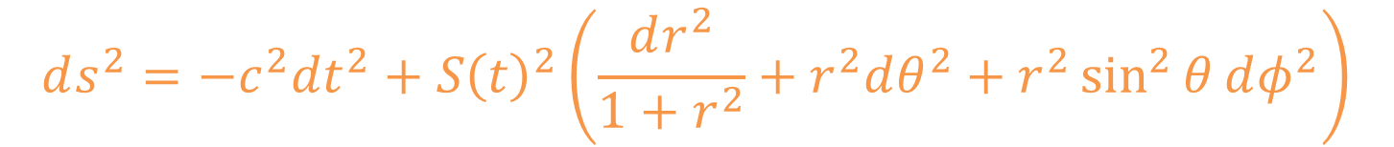
Homogeneous and isotropic spacetime metrics
$$ds^{2}=−c^{2}dt^{2}+S{\left(t\right)}^{2}\left(\frac{dr^{2}}{1−r^{2}}+r^{2}dθ^{2}+r^{2}\sin^{2}{θ}dφ^{2}\right)$$
Positive curvature:
No curvature (flat):
$$ds^{2}=−c^{2}dt^{2}+S{\left(t\right)}^{2}\left(dr^{2}+r^{2}dθ^{2}+r^{2}\sin^{2}{θ}dφ^{2}\right)$$
$$ds^{2}=−c^{2}dt^{2}+S{\left(t\right)}^{2}\left(\frac{dr^{2}}{1+r^{2}}+r^{2}dθ^{2}+r^{2}\sin^{2}{θ}dφ^{2}\right)$$
Negative curvature:

Slide 38
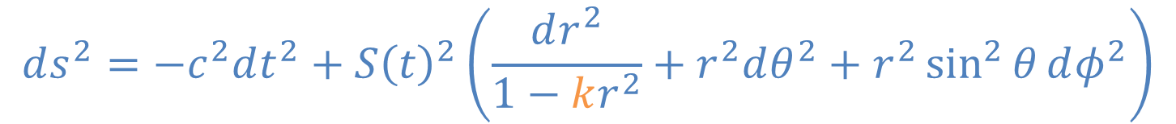
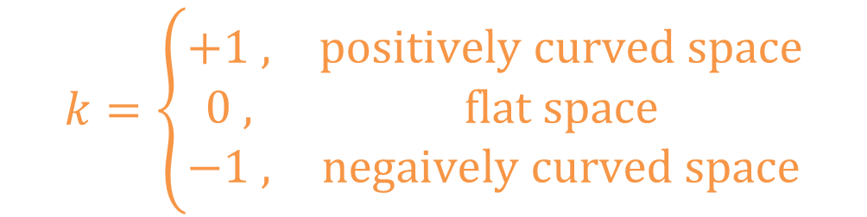
Homogeneous and isotropic spacetime metrics
$$ds^{2}=−c^{2}dt^{2}+S{\left(t\right)}^{2}\left(\frac{dr^{2}}{1−kr^{2}}+r^{2}dθ^{2}+r^{2}\sin^{2}{θ}dφ^{2}\right)$$
where
$$k=\left\{\begin{matrix}+1 , & positively curved space \\ 0 , & flat space \\ −1 , & negaively curved space\end{matrix}\right.$$
Derived independently by Friedmann, Lemaître, Robertson and Walker in 1920s-1930s. Now known as the FLRW metric.

Slide 39
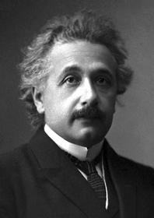
A brief look at General Relativity
Einstein’s Happiest Thought (1907):
There is no gravity!!
Gravitational field has only a relative existence.
You can feel weightless when in a gravitational field.

Slide 40
A brief look at General Relativity
Worldline of an observer moving with constant speed
Worldline of stationary observer
Worldline of a photon
Worldline of an observer moving with non-constant speed (acceleration)
Acceleration = Curve in spacetime diagram

Slide 41

A brief look at General Relativity
All bodies accelerate equally in a gravitational field
Ex. Sketch on a spacetime diagram, the worldline of:
a ball that is released from the top of the Tower of Pisa.
a ball released simultaneously with the first, from 1m below the top.
yet another ball, that is released from the top of the Tower 1s later.
Retrieved from http://www.bluffton.edu/~bergerd/classes/NSC109/Handouts/answers2-3.html

Slide 42
A brief look at General Relativity
The gravitational field defines a particular set of curves in spacetime.

Slide 43
A brief look at General Relativity
All bodies accelerate equally in a given gravitational field.
“Equally” = move along the same set of curves in spacetime.
The g-field defines the set of curves where all bodies move in.
Let us think of gravity, not as a force, but as spacetime geometry.

Slide 44
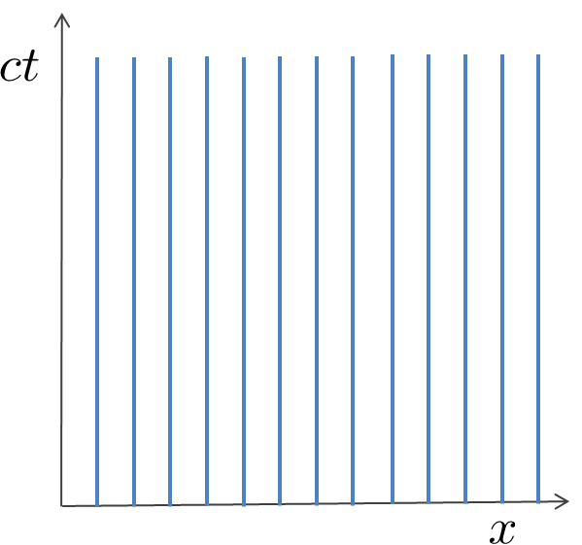
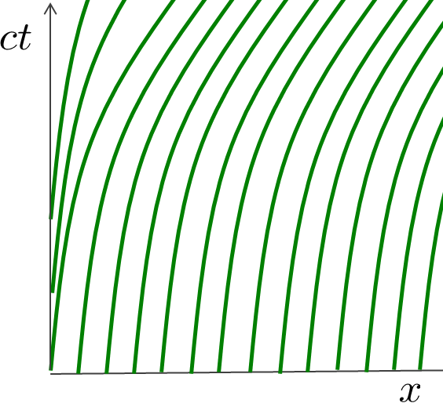
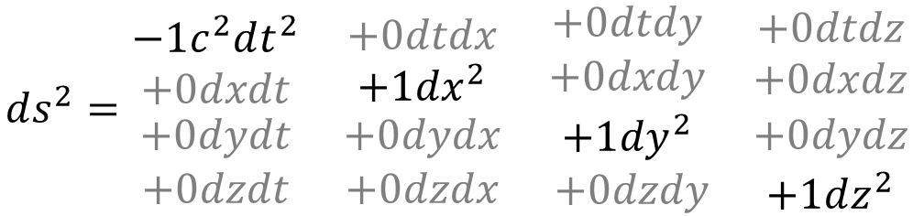
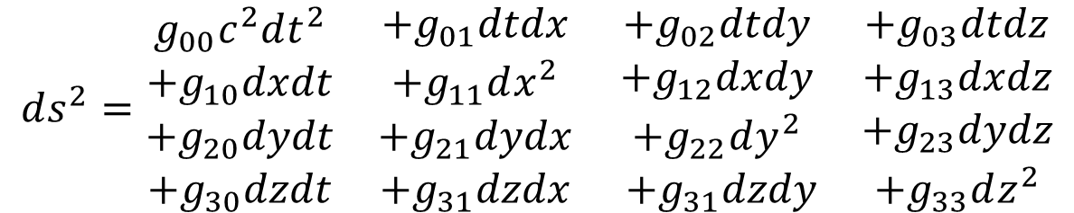
A brief look at General Relativity
Spacetime metric on Special Relativity
$$ds^{2}=\begin{matrix}\begin{matrix}\begin{matrix}−1c^{2}dt^{2} \\ +0dxdt\end{matrix} & \begin{matrix}+0dtdx \\ +1dx^{2}\end{matrix} \\ \begin{matrix}+0dydt \\ +0dzdt\end{matrix} & \begin{matrix}+0dydx \\ +0dzdx\end{matrix}\end{matrix} & \begin{matrix}\begin{matrix}+0dtdy \\ +0dxdy\end{matrix} & \begin{matrix}+0dtdz \\ +0dxdz\end{matrix} \\ \begin{matrix}+1dy^{2} \\ +0dzdy\end{matrix} & \begin{matrix}+0dydz \\ +1dz^{2}\end{matrix}\end{matrix}\end{matrix}$$
Spacetime metric on General Relativity
$$ds^{2}=\begin{matrix}\begin{matrix}\begin{matrix}g_{00}c^{2}dt^{2} \\ +g_{10}dxdt\end{matrix} & \begin{matrix}+g_{01}dtdx \\ +g_{11}dx^{2}\end{matrix} \\ \begin{matrix}+g_{20}dydt \\ +g_{30}dzdt\end{matrix} & \begin{matrix}+g_{21}dydx \\ +g_{31}dzdx\end{matrix}\end{matrix} & \begin{matrix}\begin{matrix}+g_{02}dtdy \\ +g_{12}dxdy\end{matrix} & \begin{matrix}+g_{03}dtdz \\ +g_{13}dxdz\end{matrix} \\ \begin{matrix}+g_{22}dy^{2} \\ +g_{31}dzdy\end{matrix} & \begin{matrix}+g_{23}dydz \\ +g_{33}dz^{2}\end{matrix}\end{matrix}\end{matrix}$$

Slide 45
A brief look at General Relativity
Space tells matter how move

Slide 46

A brief look at General Relativity
Einstein’s field equation (1916):
A link between the amount of energy (matter) and the curvature of spacetime
$$R_{ab}−\frac{1}{2}Rg_{ab}=\frac{8πG}{c^{4}}T_{ab}$$
Energy content
Spacetime part
Space tells matter how move, matter tells space how to curve

Slide 47



A brief look at General Relativity
Einstein’s field equation applied to Homogeneous and Isotropic Universe
$$\frac{{\dot{S}(t)}^{2}+kc^{2}}{{S(t)}^{2}}=\frac{8πG}{3}ρ(t)$$
$$R_{ab}−\frac{1}{2}Rg_{ab}=\frac{8πG}{c^{4}}T_{ab}$$
$$−2\frac{\ddot{S}\left(t\right)}{S\left(t\right)}−\frac{{\dot{S}(t)}^{2}+kc^{2}}{{S(t)}^{2}}=\frac{8πG}{c^{2}}p(t)$$
Homogeneous and isotropic Energy content
FLRW metric
$$ds^{2}=−c^{2}dt^{2}+S{\left(t\right)}^{2}\left(\frac{dr^{2}}{1−kr^{2}}+r^{2}dθ^{2}+r^{2}\sin^{2}{θ}dφ^{2}\right)$$

Slide 48


Friedmann equations
Putting the FLRW metric into Einstein’s equation yields:
$$\frac{{\dot{S}(t)}^{2}+kc^{2}}{{S(t)}^{2}}=\frac{8πG}{3}ρ(t)$$
$$−2\frac{\ddot{S}\left(t\right)}{S\left(t\right)}−\frac{{\dot{S}(t)}^{2}+kc^{2}}{{S(t)}^{2}}=\frac{8πG}{c^{2}}p(t)$$
Solve the differential equations to obtain $S\left(t\right)$.
$S\left(t\right)$ tells the story of how the size of the Universe evolves.

Slide 49





Energy density and Pressure
Energy density:
$$ρ(t)$$
Pressure:
$$p(t)$$
$$w=\frac{p}{ρc^{2}}$$
$w$ characterises the type of fluid.
$w$ is a constant in time.
Equation of state:
$$\frac{{\dot{S}(t)}^{2}+kc^{2}}{{S(t)}^{2}}=\frac{8πG}{3}ρ(t)$$
$$ρ∝S^{−3\left(1+w\right)}$$
Details on pg 13 of lecture notes.
$$−2\frac{\ddot{S}\left(t\right)}{S\left(t\right)}−\frac{{\dot{S}(t)}^{2}+kc^{2}}{{S(t)}^{2}}=\frac{8πG}{c^{2}}p(t)$$

Slide 50







Matter-dominated Universe
Energy density:
$$ρ\left(t\right)∝S^{−3}$$
Pressure:
$$p\left(t\right)=0$$
Equation of state:
$$w=\frac{p}{ρc^{2}}=0$$
$$\frac{{\dot{S}(t)}^{2}+kc^{2}}{{S(t)}^{2}}=\frac{8πG}{3}ρ(t)$$
$${\dot{S}}^{2}+kc^{2}∝S^{−1}$$
$$−2\frac{\ddot{S}\left(t\right)}{S\left(t\right)}−\frac{{\dot{S}(t)}^{2}+kc^{2}}{{S(t)}^{2}}=\frac{8πG}{c^{2}}p(t)$$
$$\ddot{S}∝−S^{−2}$$

Slide 51




Radiation-dominated Universe
Energy density:
$$ρ\left(t\right)∝S^{−4}$$
Why? Consider cosmological redshift!
$$p\left(t\right)=\frac{1}{3}ρc^{2}$$
Pressure:
$$w=\frac{p}{ρc^{2}}=\frac{1}{3}$$
Equation of state:
$$\frac{{\dot{S}(t)}^{2}+kc^{2}}{{S(t)}^{2}}=\frac{8πG}{3}ρ(t)$$
$${\dot{S}}^{2}+kc^{2}∝S^{−2}$$

Slide 52




Dark Energy-dominated Universe
Energy density:
$$ρ\left(t\right)=constant$$
!!!
Pressure:
$$p\left(t\right)=−ρc^{2}$$
Equation of state:
$$w=\frac{p}{ρc^{2}}=−1$$
$$\frac{{\dot{S}(t)}^{2}+kc^{2}}{{S(t)}^{2}}=\frac{8πG}{3}ρ(t)$$
$${\dot{S}}^{2}+kc^{2}=\frac{Λ}{3}S^{2}$$

Slide 53
What if the scale factor of our Universe is currently accelerating? How will Hubble’s plot change?
Velocity
Distance

Slide 54



What if the scale factor of our Universe is currently accelerating? How will Hubble’s plot change?
Velocity
$$\ddot{S}<0$$
$$\ddot{S}=0$$
$$\ddot{S}>0$$
Universe is accelerating.
(Slower in the past)
Distance
[Far away = past]

Slide 55


What if the scale factor of our Universe is currently accelerating? How will Hubble’s plot change?
Distance (Brightness)
$$\ddot{S}>0$$
$$\ddot{S}=0$$
[Far away = past]
Accelerating. (Last time slower)
$$\ddot{S}<0$$
Velocity (Redshift)

Slide 56
Observations using Supernovae finds our Universe accelerating!
2011 Physics Nobel Prize

